Slide 1

Data422 Project
Team: GLWY

Slide 2
Introduction
This project is regarding data sourcing and wrangling that centres on Covid – 19.
In preparation for data analysis on the impact of Covid-19 on economy, education and demographic aspects.

Slide 3
Data Source
WHO Coronavirus Disease Dataset:
https://covid19.who.int/
World Bank Open Data:
https://data.worldbank.org/
OCHA Services Dataset: HUMANITARIAN DATA EXCHANGE
https://data.humdata.org/dataset

Slide 4
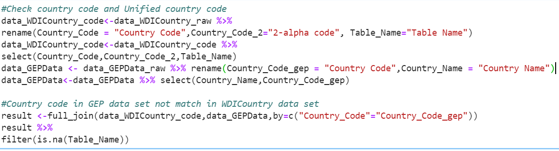
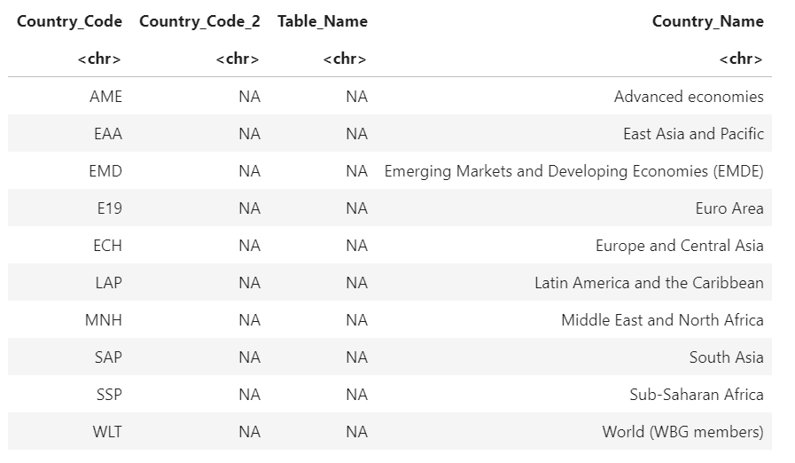
Process & Delivered Dataset
Due to the different sources of the data, we need to match the country codes.
We select the country code of WDI Country dataset as the basis.

Slide 5
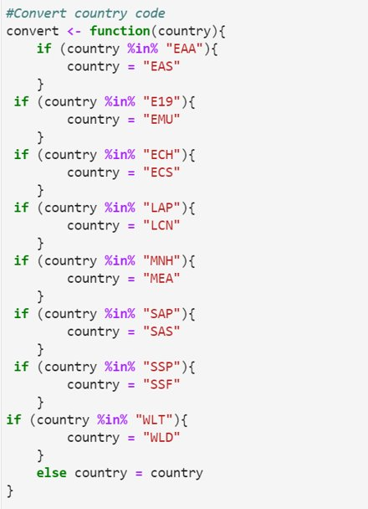
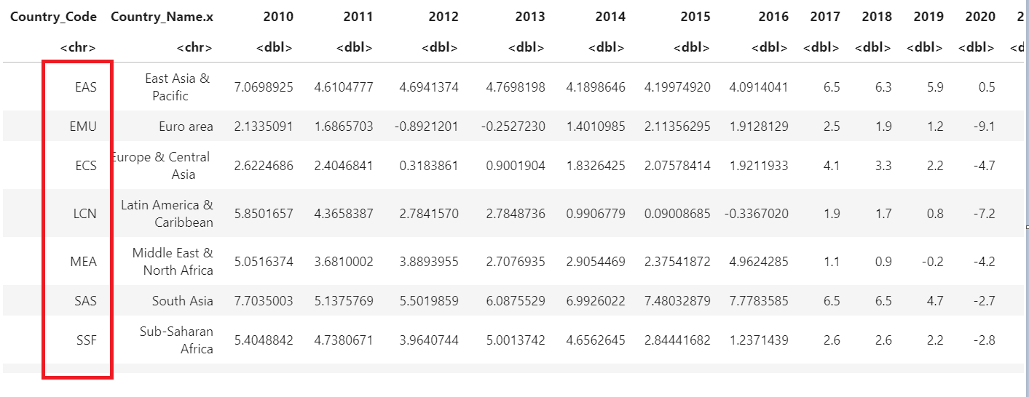
Join all country code data in one dataframe
Find out the different country codes
Use function to replace them with the same country codes.

Slide 6
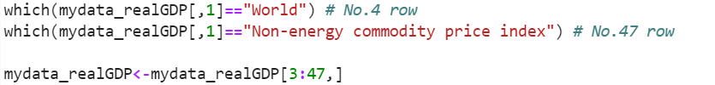
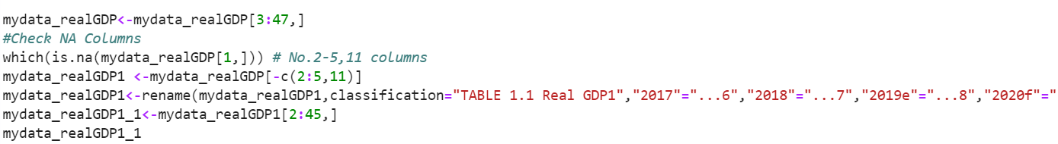
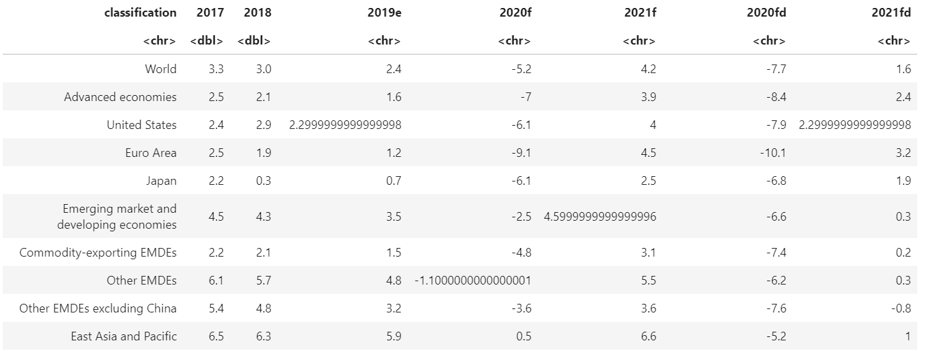
Import data into R basing on each Tab
According to the key words, use the which function to get data position.
Combine all tabs data
Remove NA and Rename columns' name

Slide 7
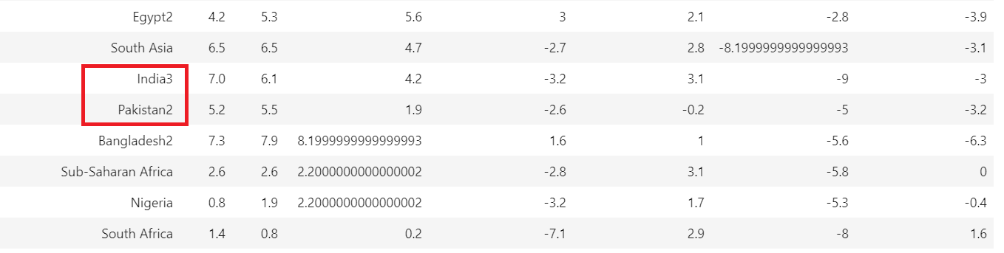
Some of the data contains subscripts and comma
Use regular expressions to remove subscripts and comma

Slide 8
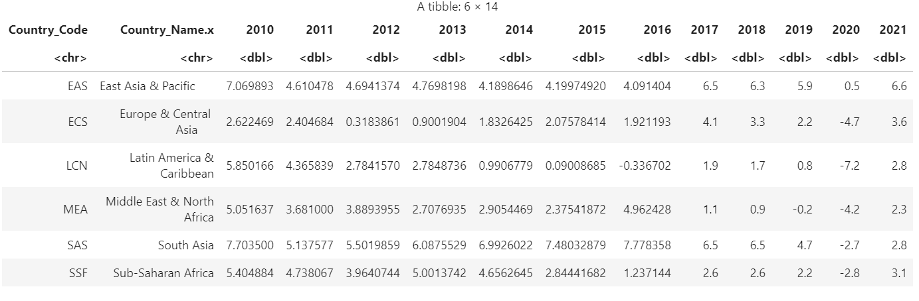
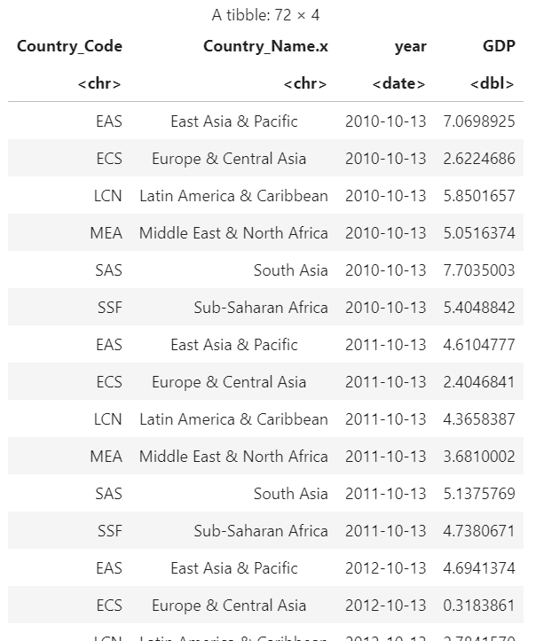
Reshaping data frame from wide to long

Slide 9
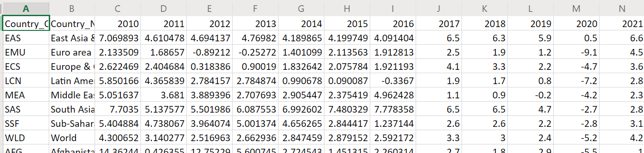
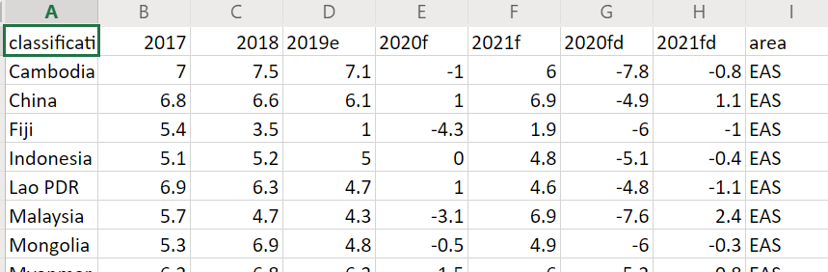
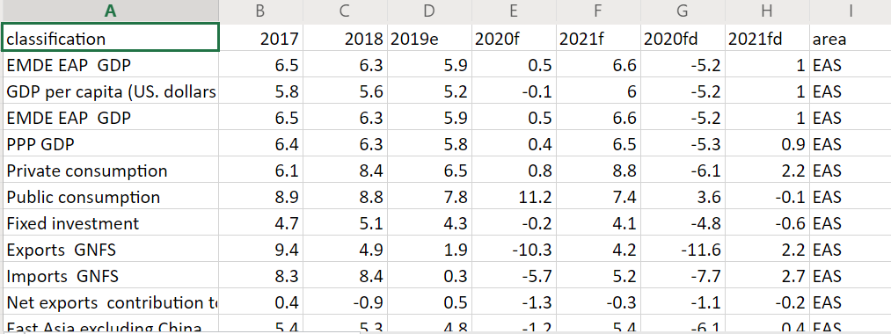
GDP history from 2010 to 2021
Estimate GDP and Forecast GDP by Area
Summary of Economic Indicates

Slide 10
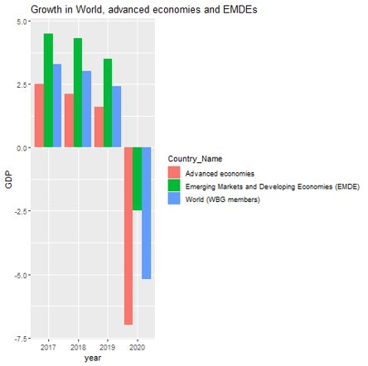
GDP growth is negative in 2020, especially in developed economies

Slide 11
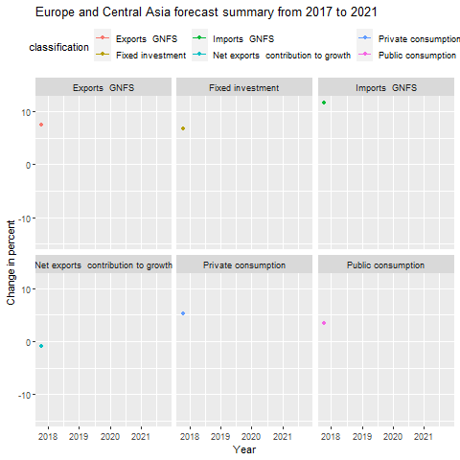
Four of the indicators dropped significantly in 2020

Slide 12
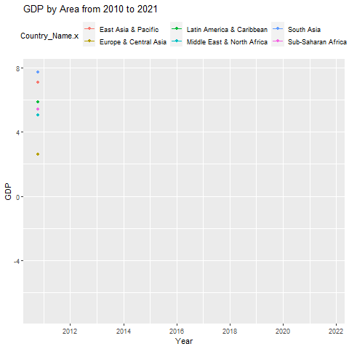
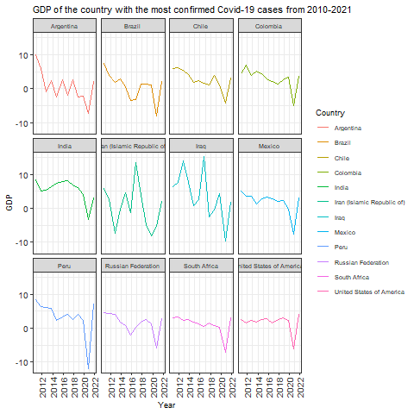

Slide 13
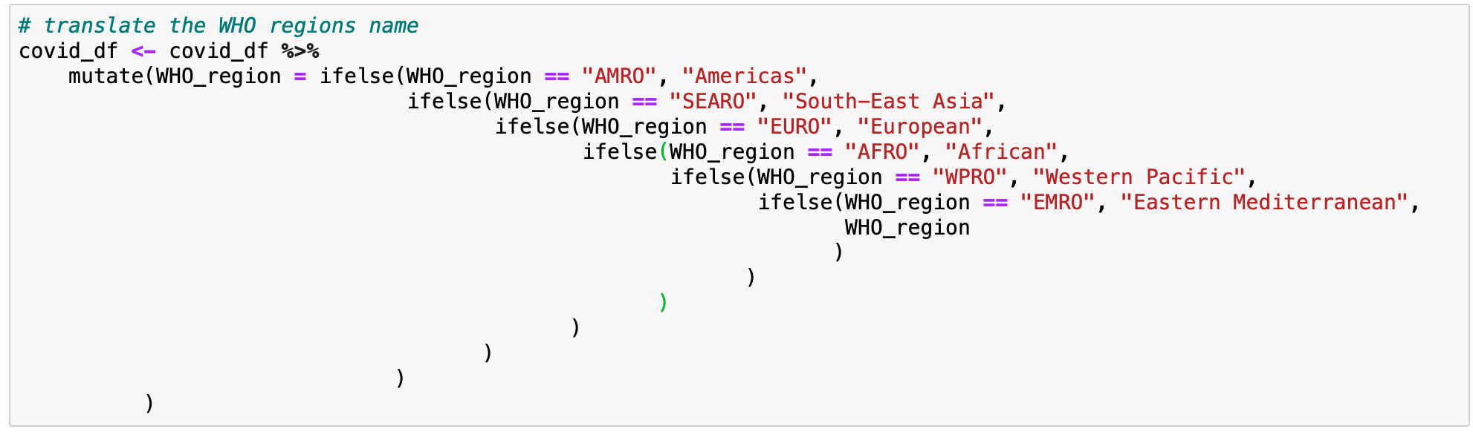
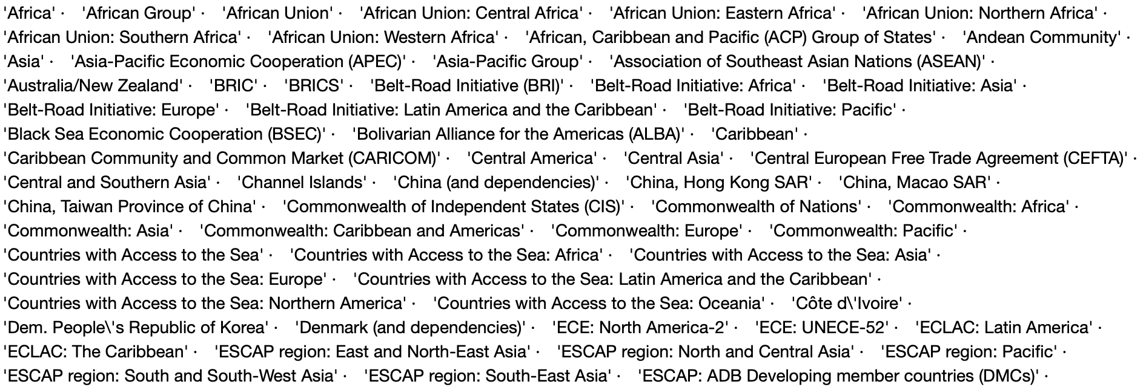
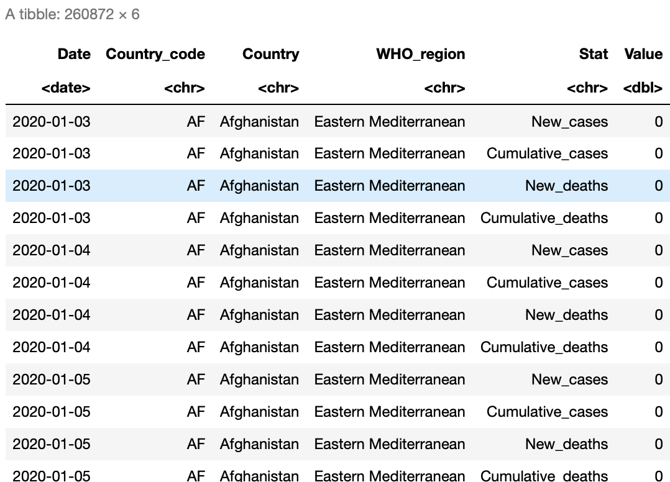
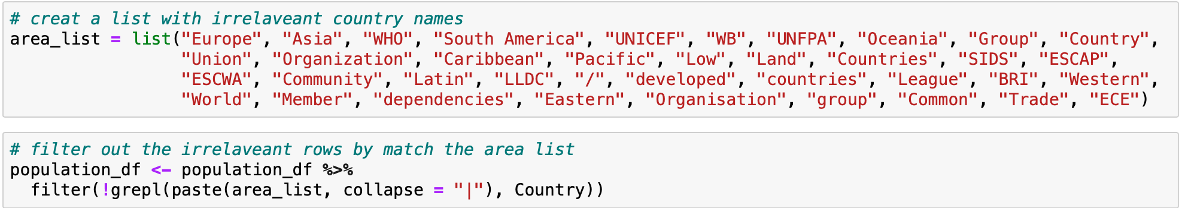
Covid-19 dataframe
Population dataframe
Translate WHO region
Deal with other names in country column
Reshape to long

Slide 14
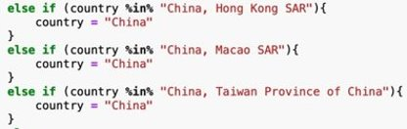
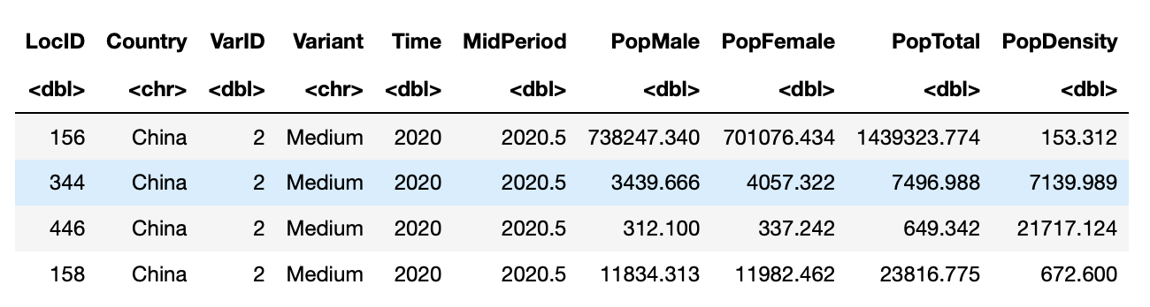
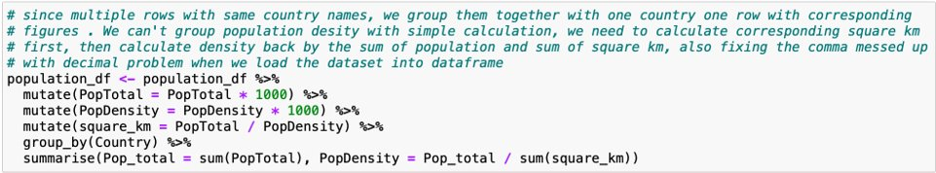
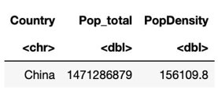
Join Covid-19 and Population dataframe
One country in each row

Slide 15
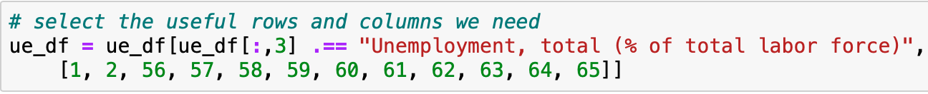
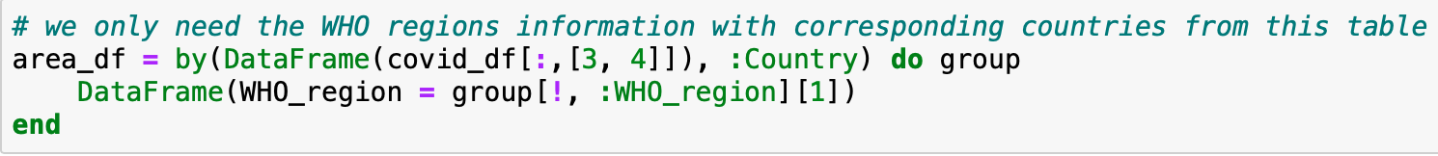
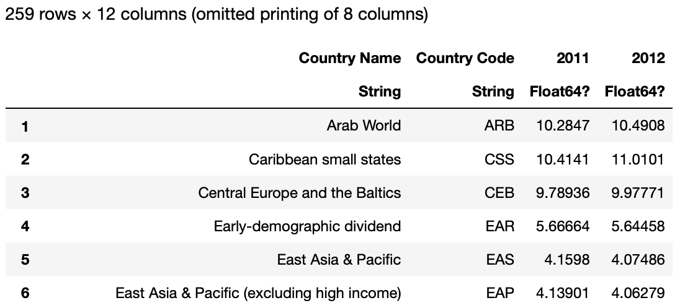
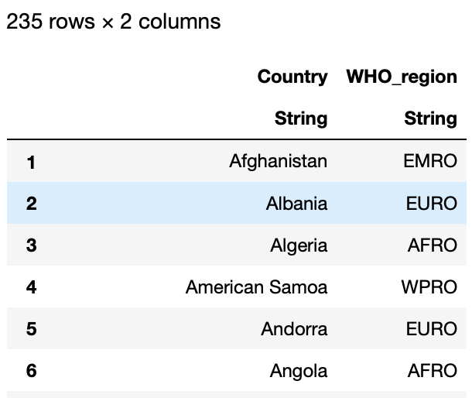
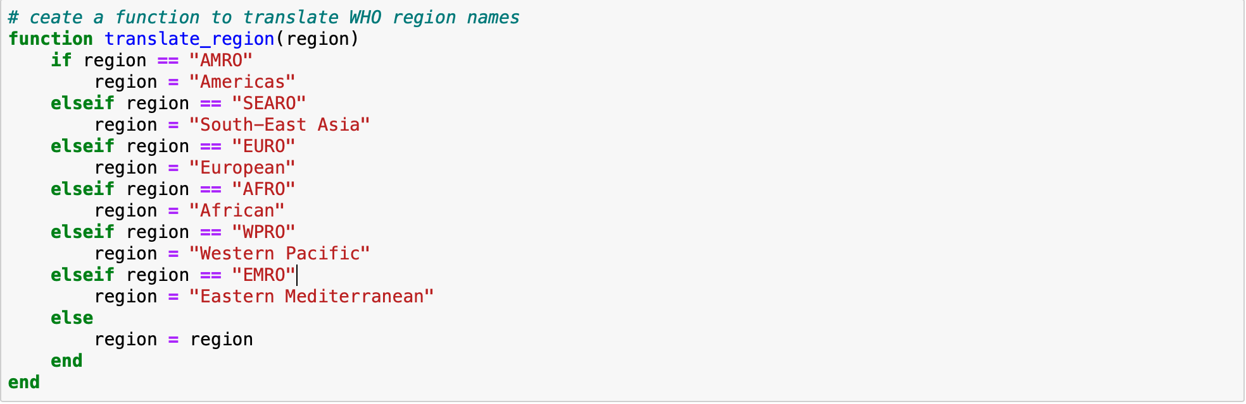
Julia with Unemployment Rate dataset
Extract unemployment data from HNP dataset
Extract WHO region from Covid-19 dataset
Translate the WHO region code
Reshape to long

Slide 16
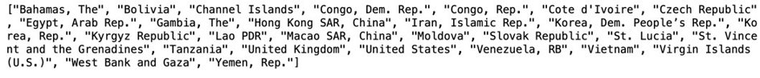
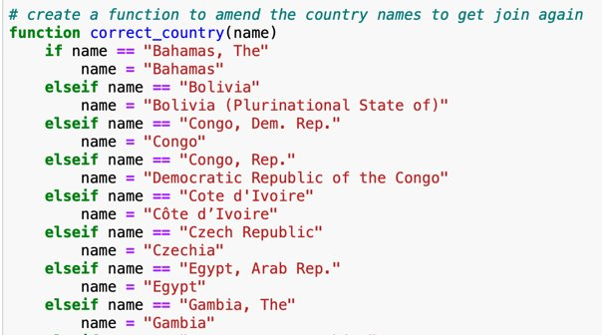
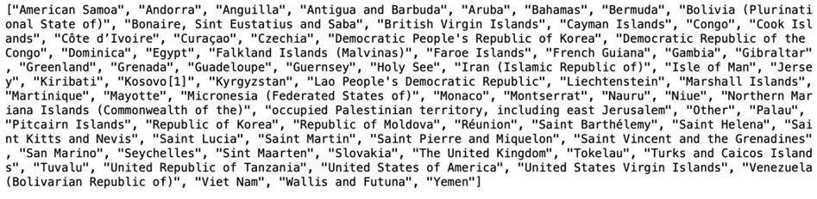
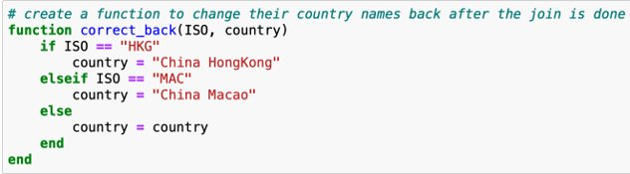
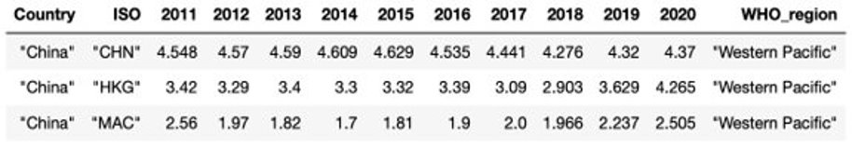
Join unemployment with WHO region data frame by country
Manually correct unmatched countries
One country code with one set of unemployment figures each row

Slide 17
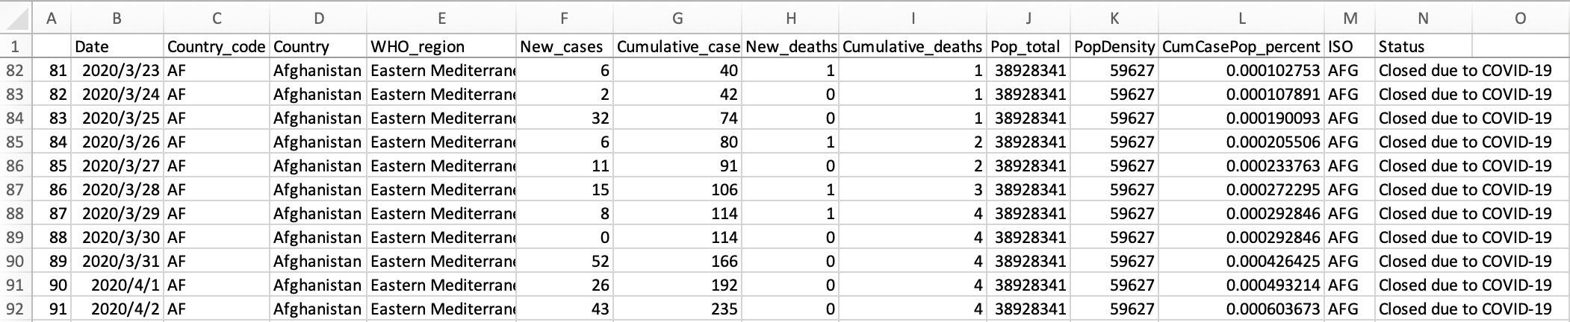
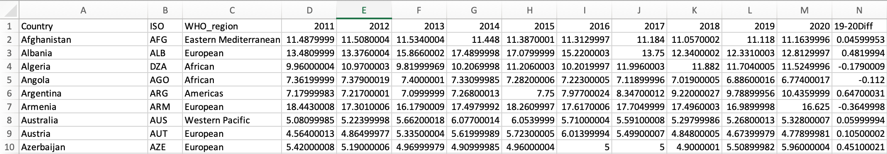
Deliverable Dataset
Covid-19 with population and education status
Unemployment

Slide 18
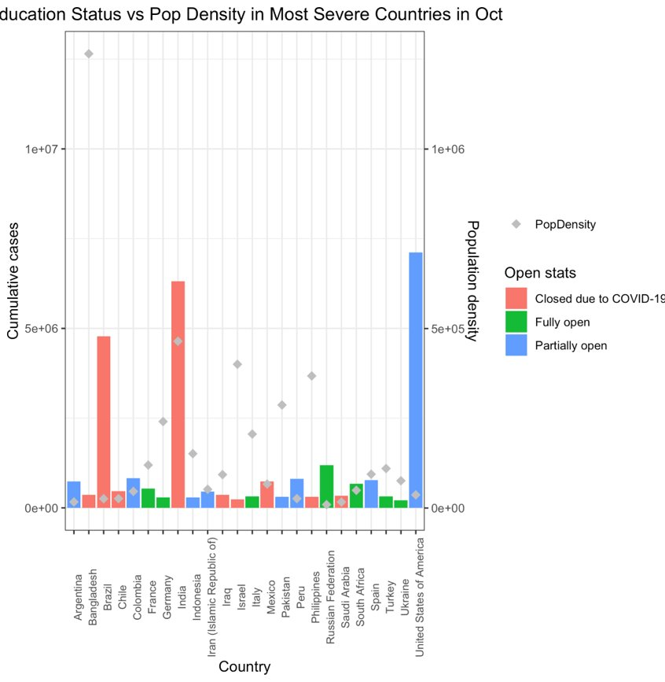
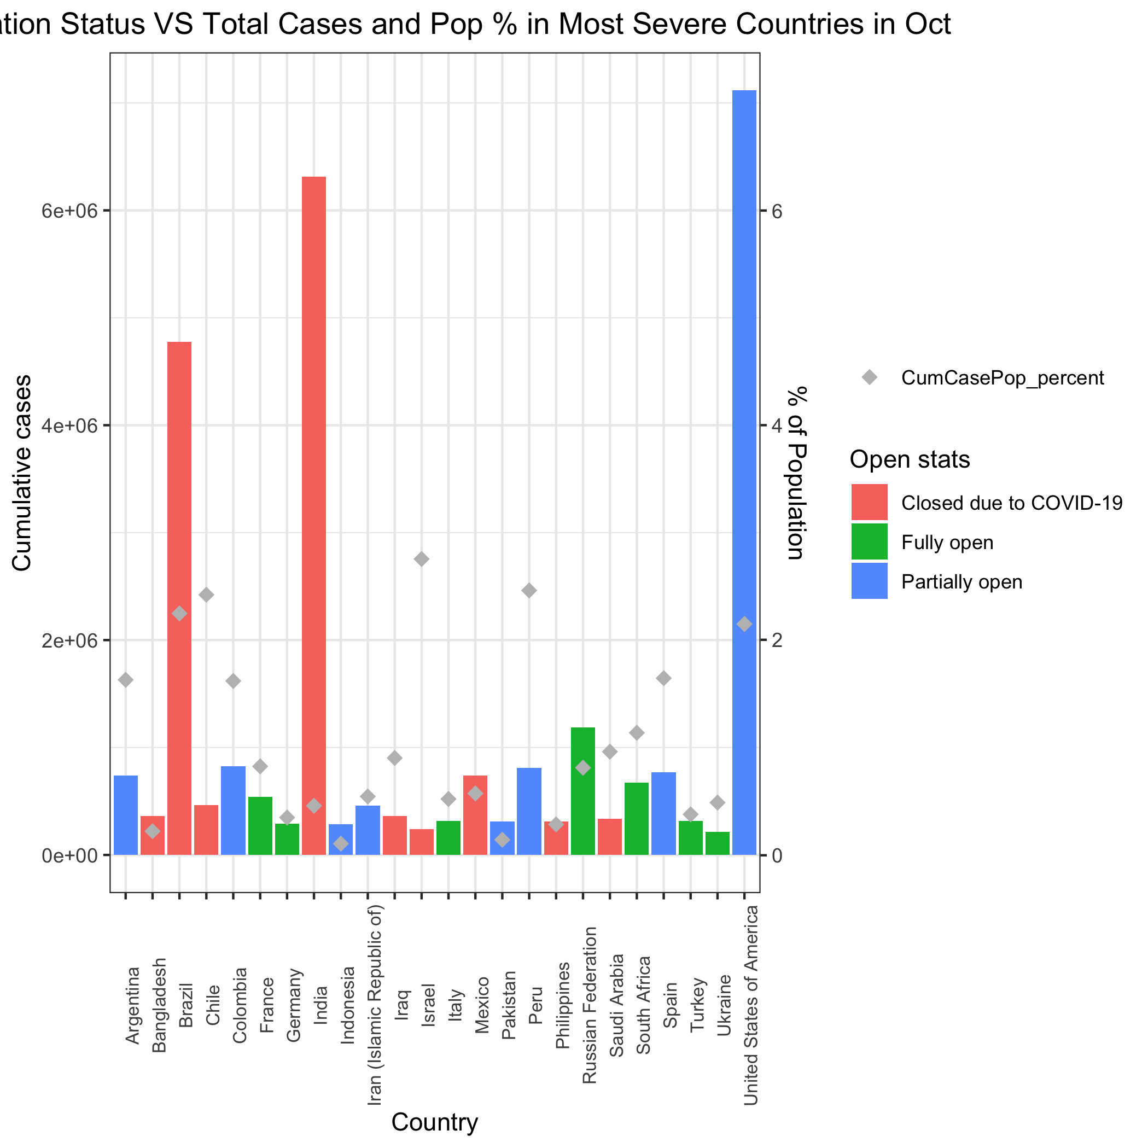
The impact of cumulative cases, population density and total cases in percentage of population on status of educational organisitions in October

Slide 19
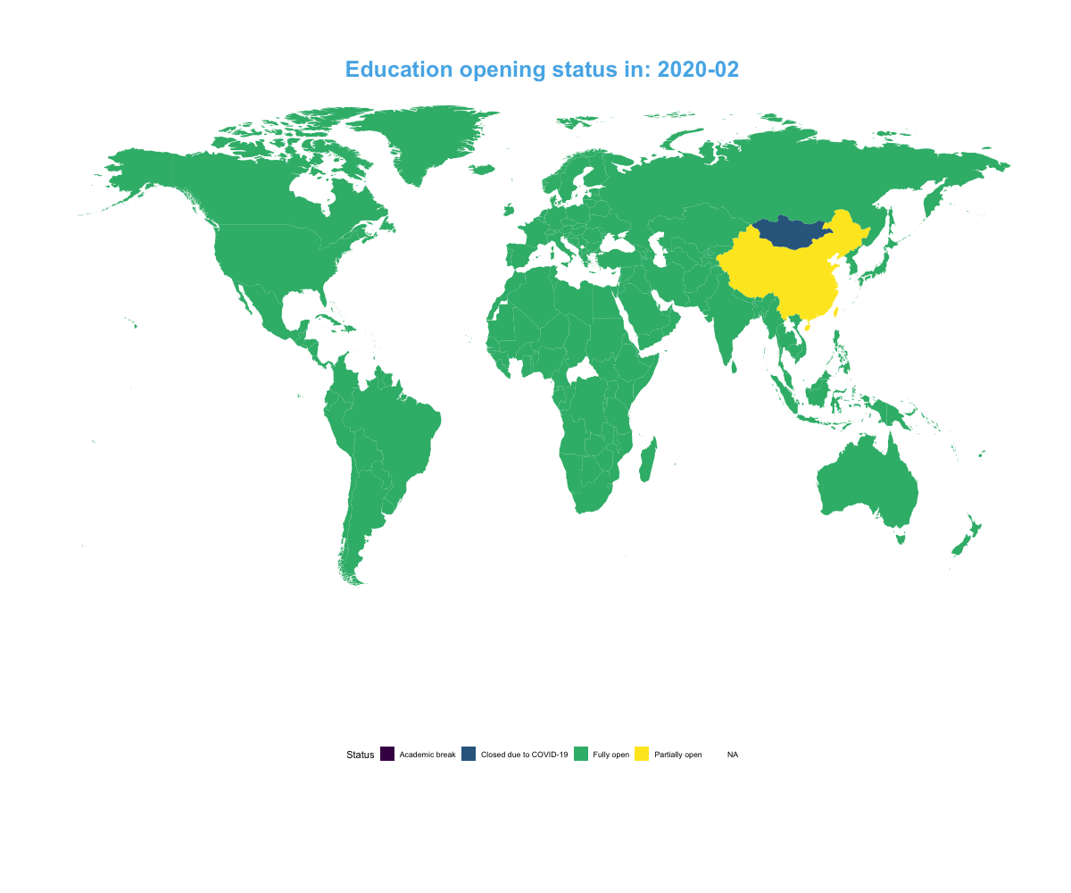
Status of educational institutes worldwide from 2020 Feb to 2020 Oct (monthly)

Slide 20
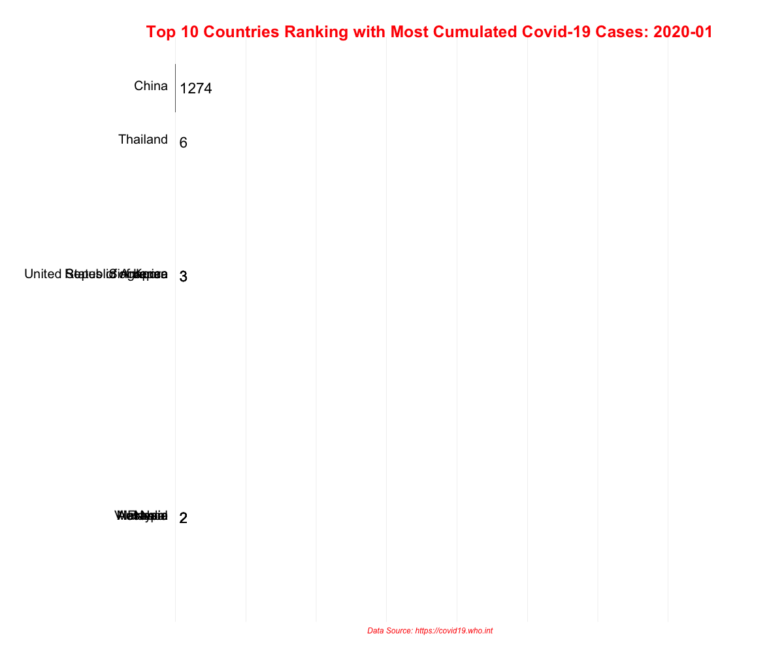
Top 10 countries with the most cumulative confirmed cases from 2020 Jan to present

Slide 21
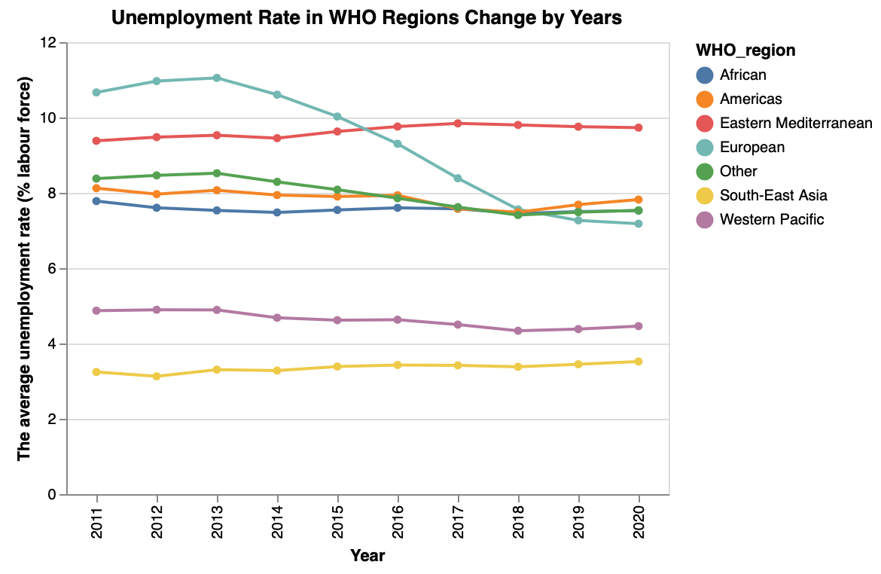
Unemployment rates changes in the last decade( by region defined by WHO)
The result is unexpected

Slide 22
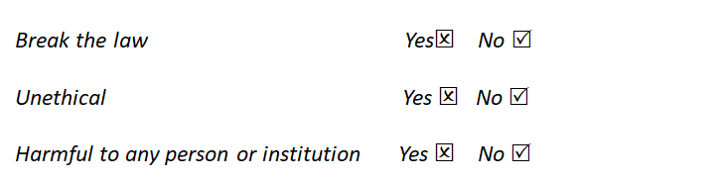
Legality and Ethics
WHO: Terms and Condition of Data Policy
https://www.who.int/about/who-we-are/publishing-policies/data-policy/terms-and-conditions
World Bank: Terms of Use for Datasets
https://www.worldbank.org/en/about/legal/terms-of-use-for-datasets

Slide 23
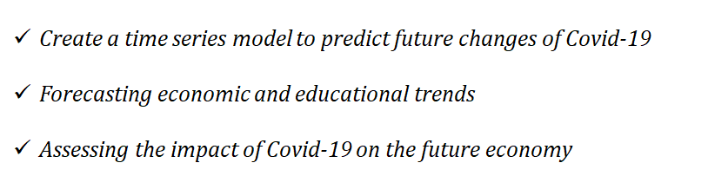
Intended Use
Used as the basis for many different directions of research

